Slide 1
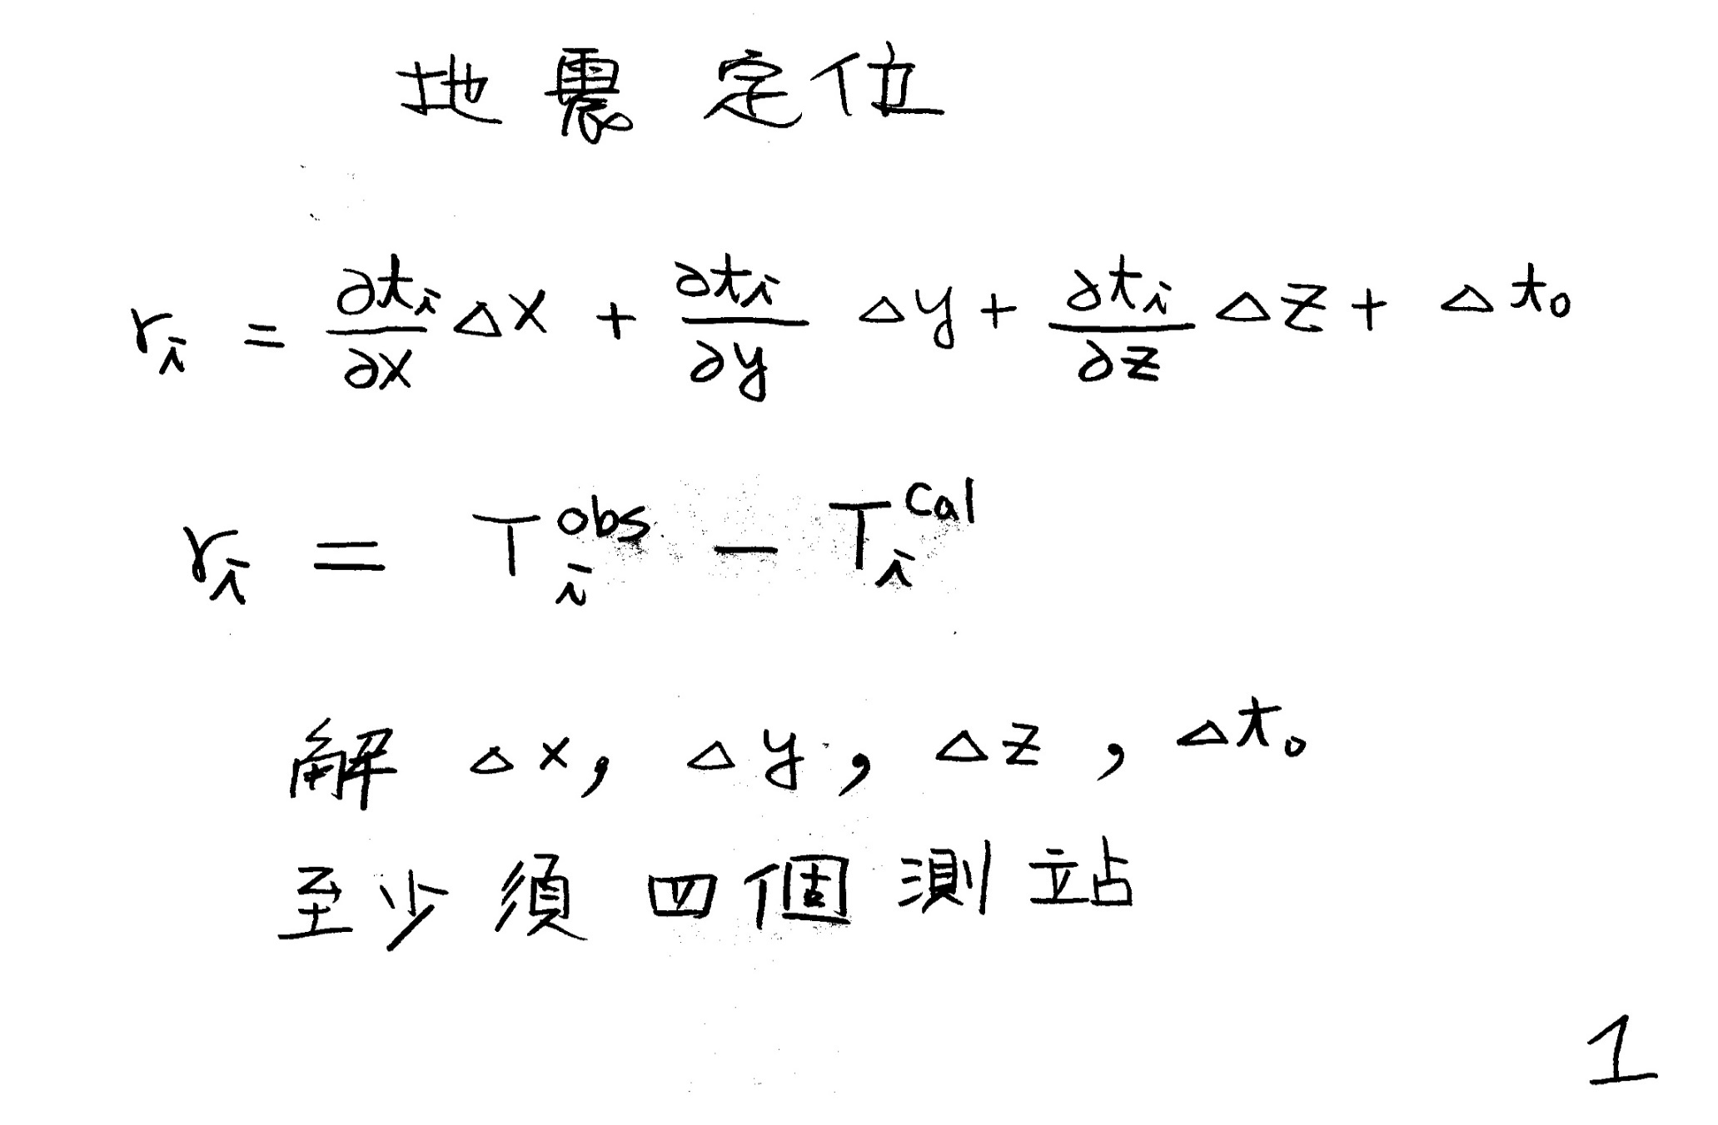
Earthquake location to solve dx, dy, dz, and dt at least four stations are needed.

Slide 2
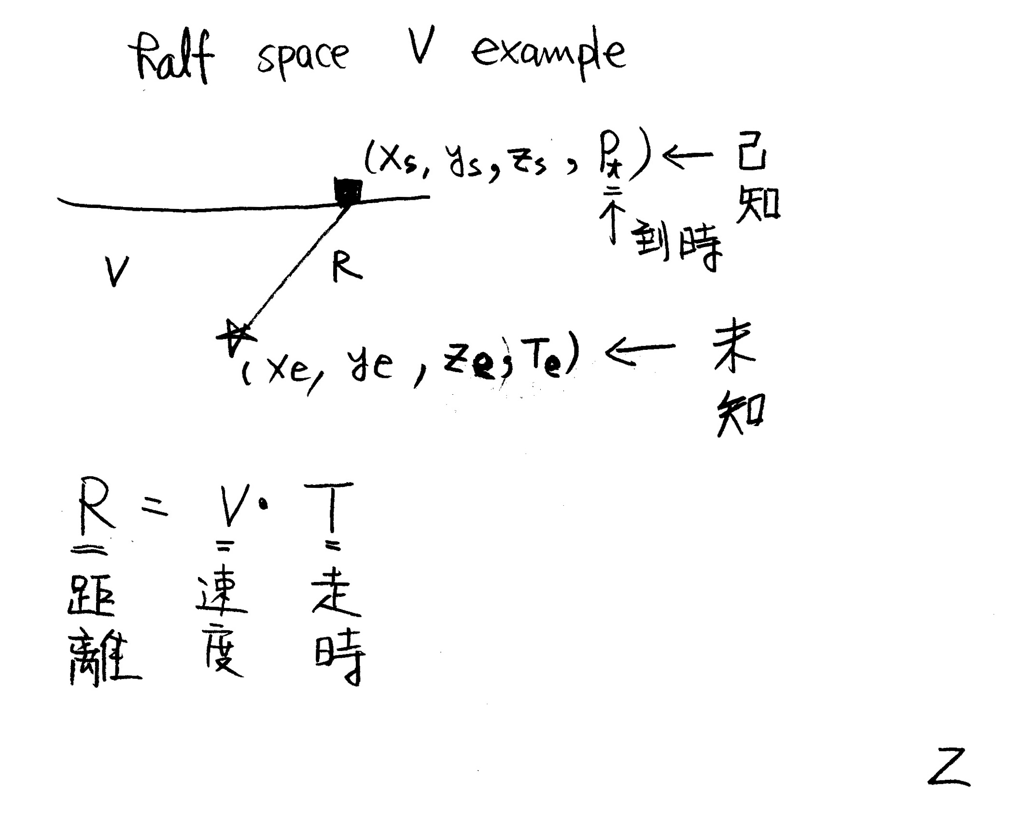

Slide 3
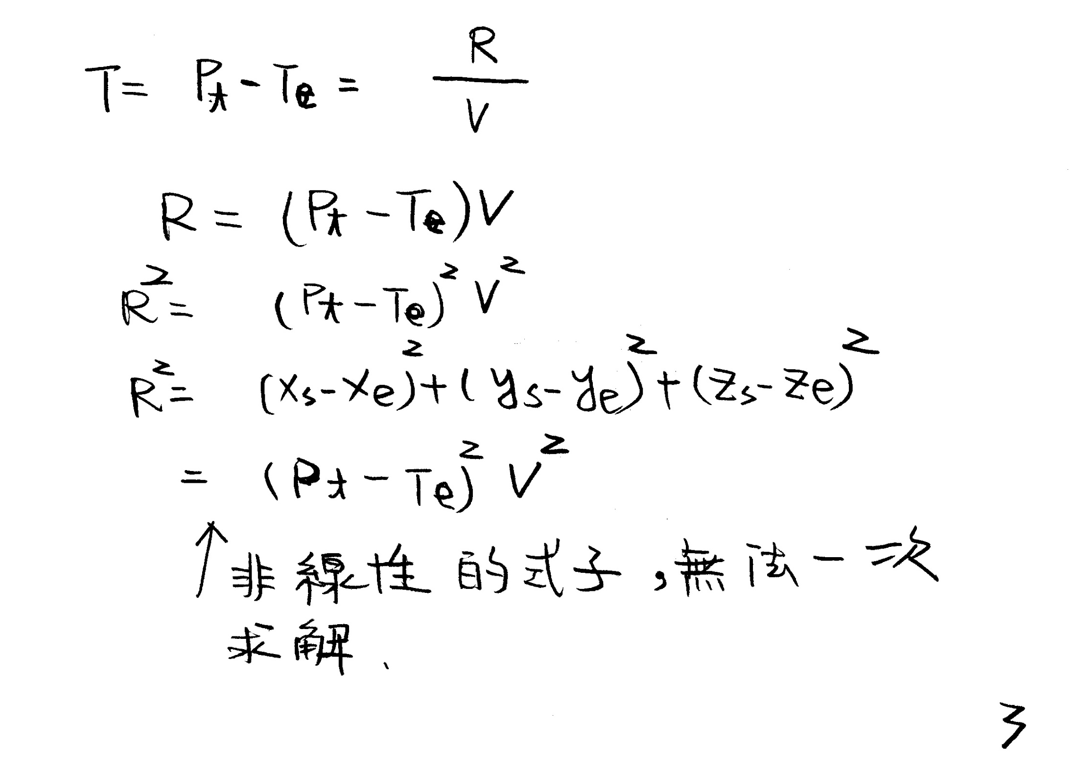

Slide 4
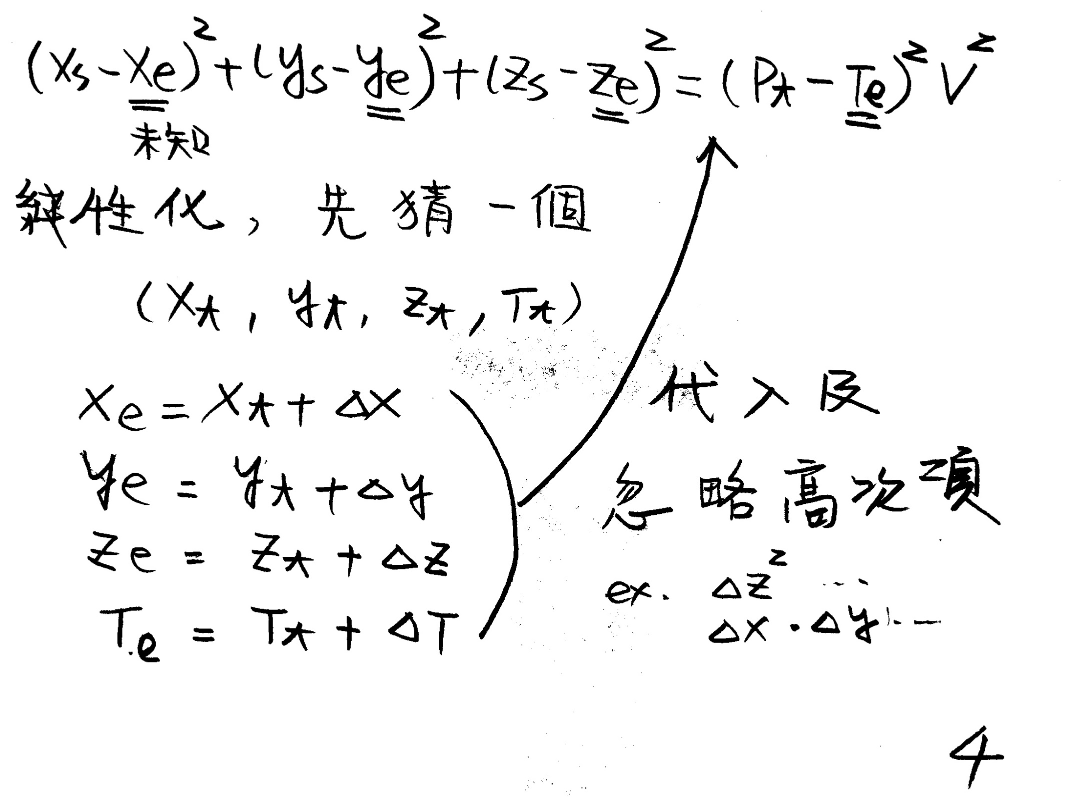

Slide 5
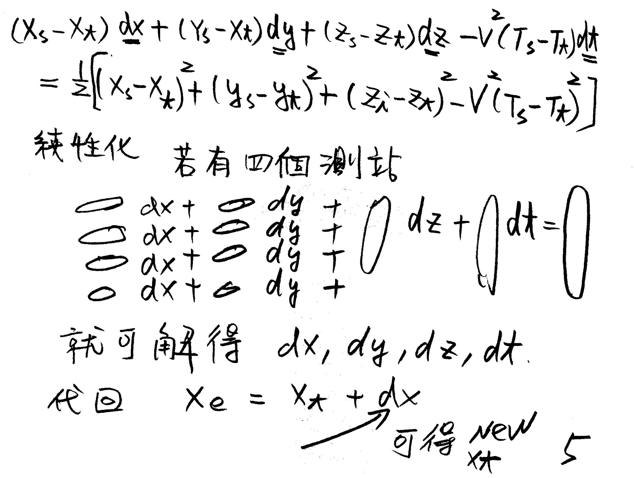

Slide 6
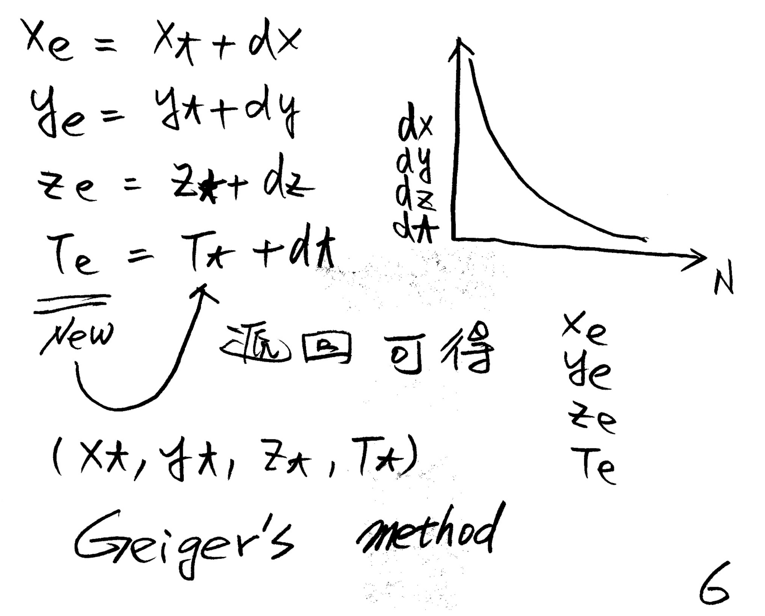

Slide 7
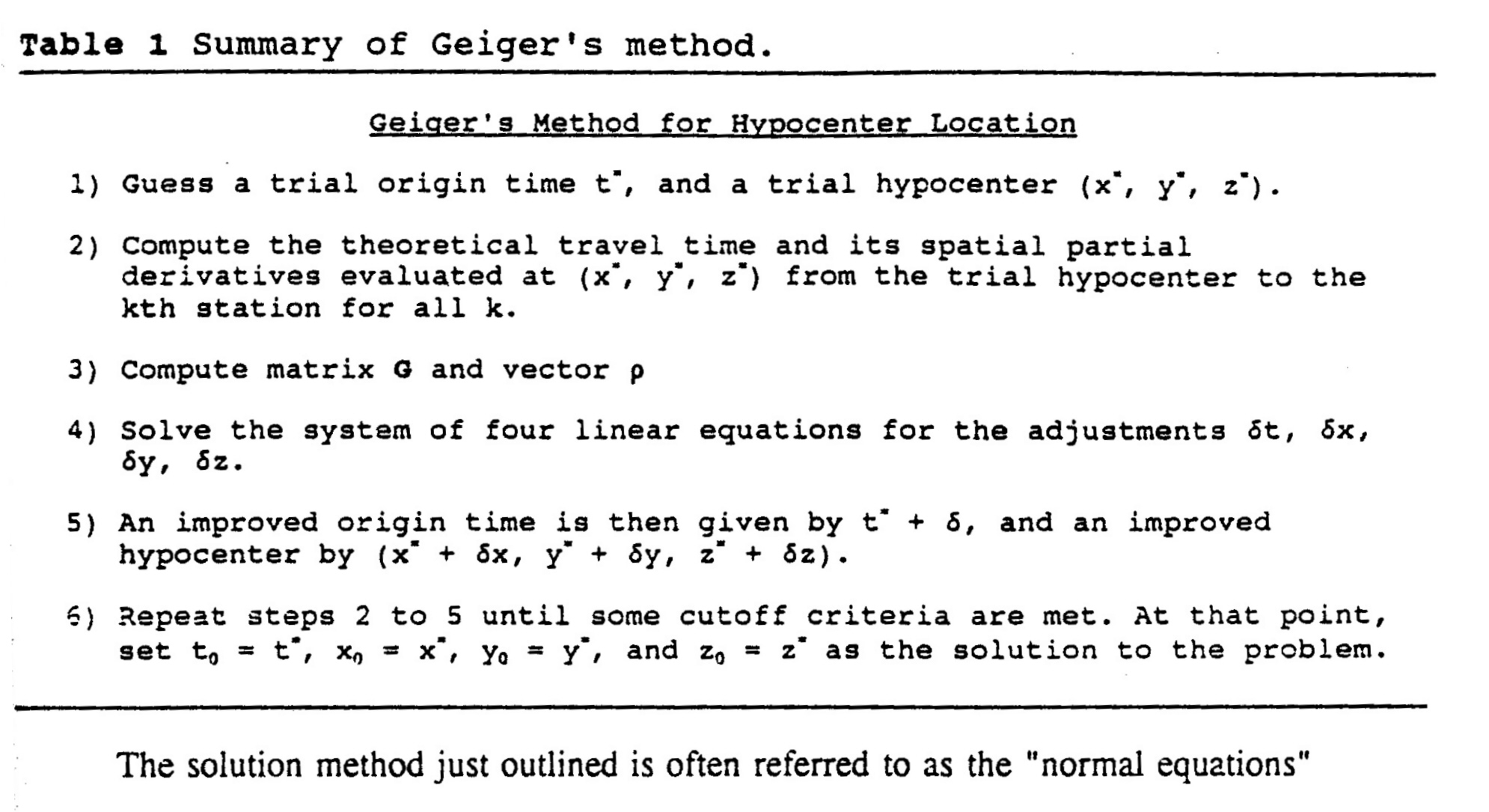

Slide 8
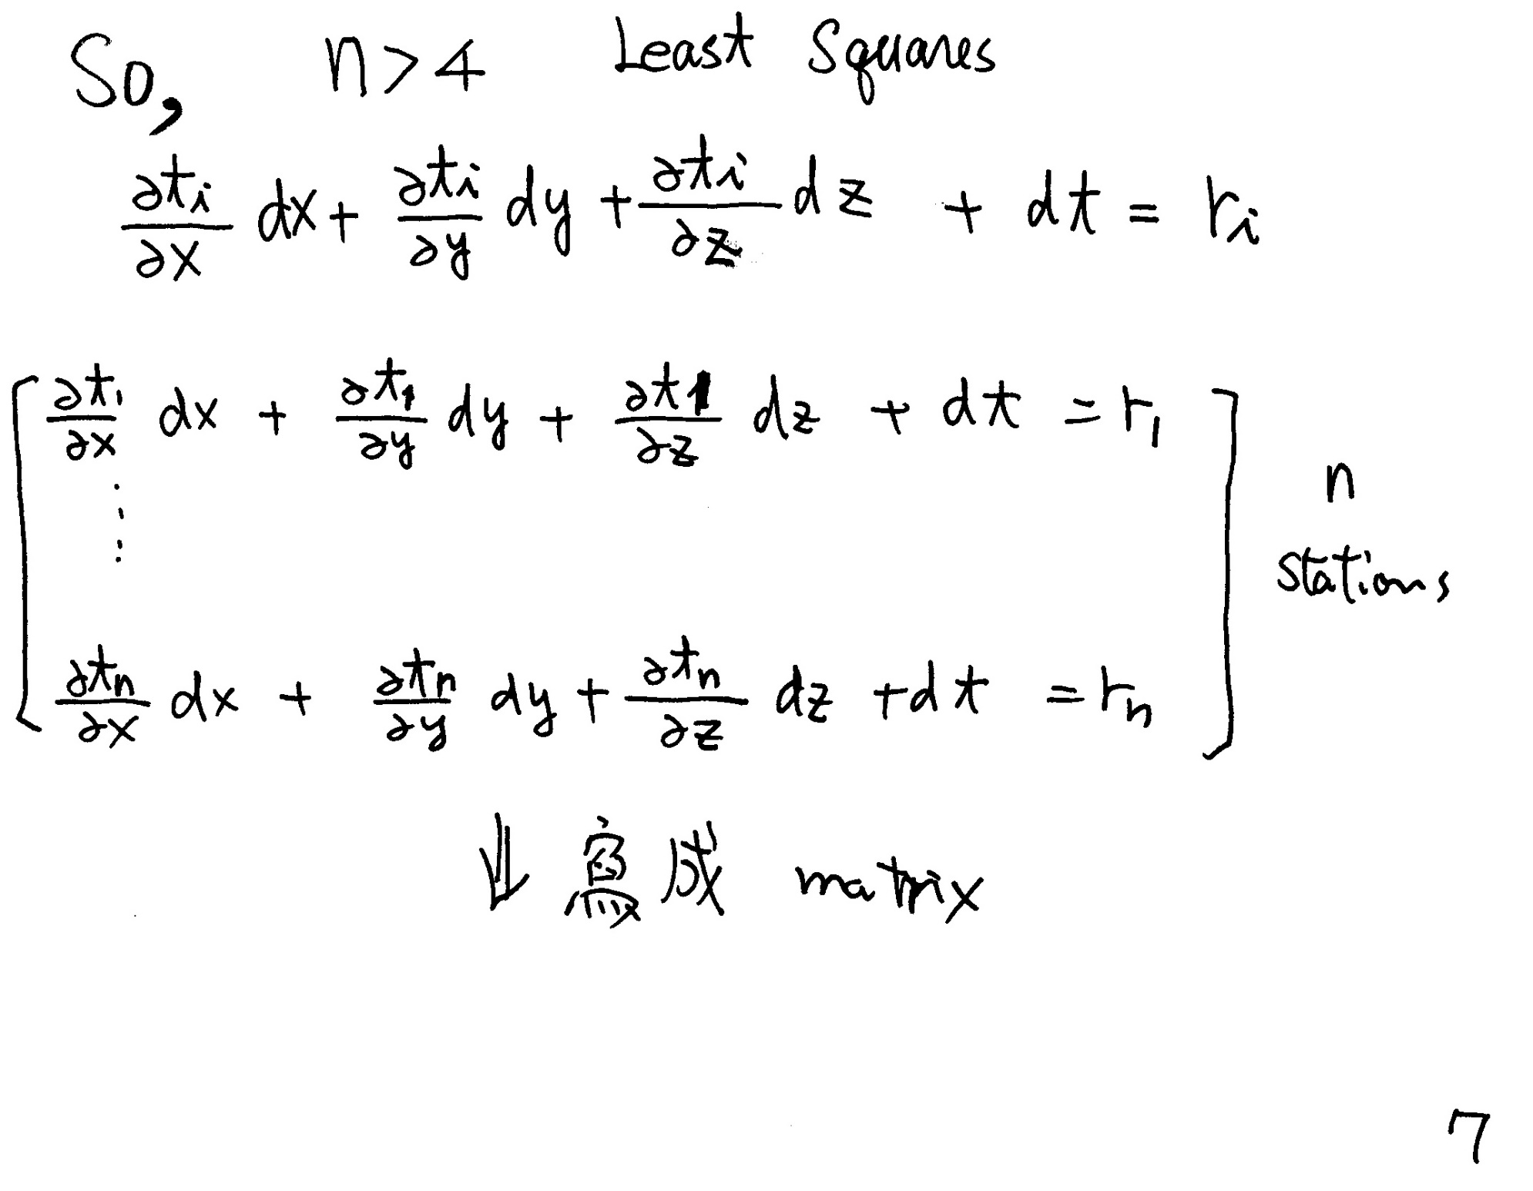

Slide 9
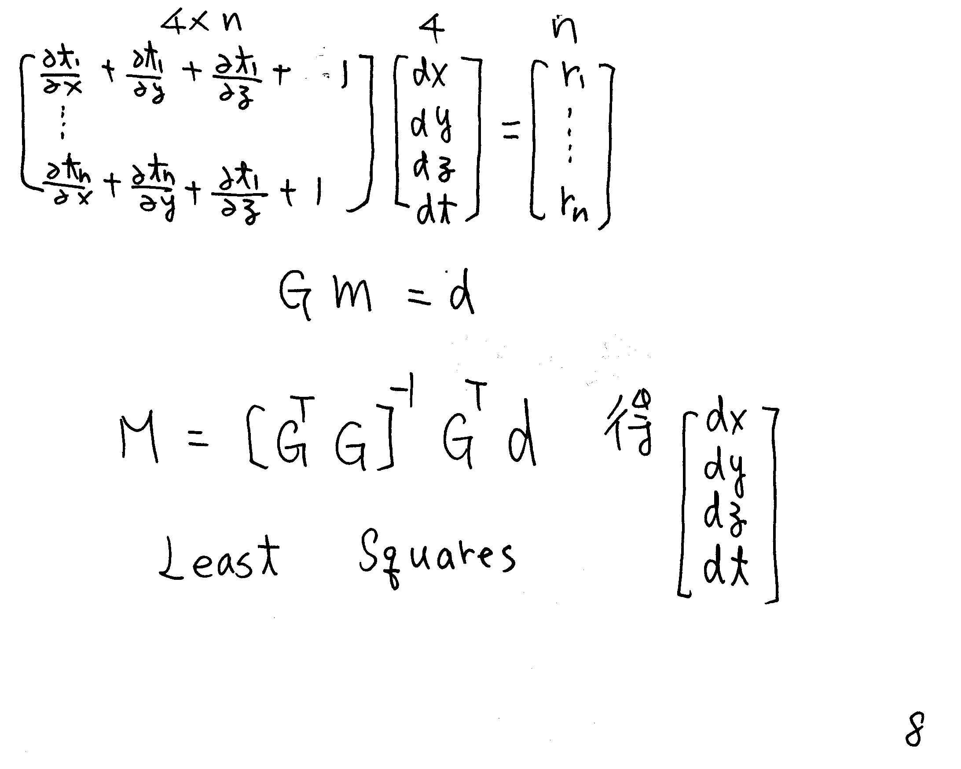

Slide 10
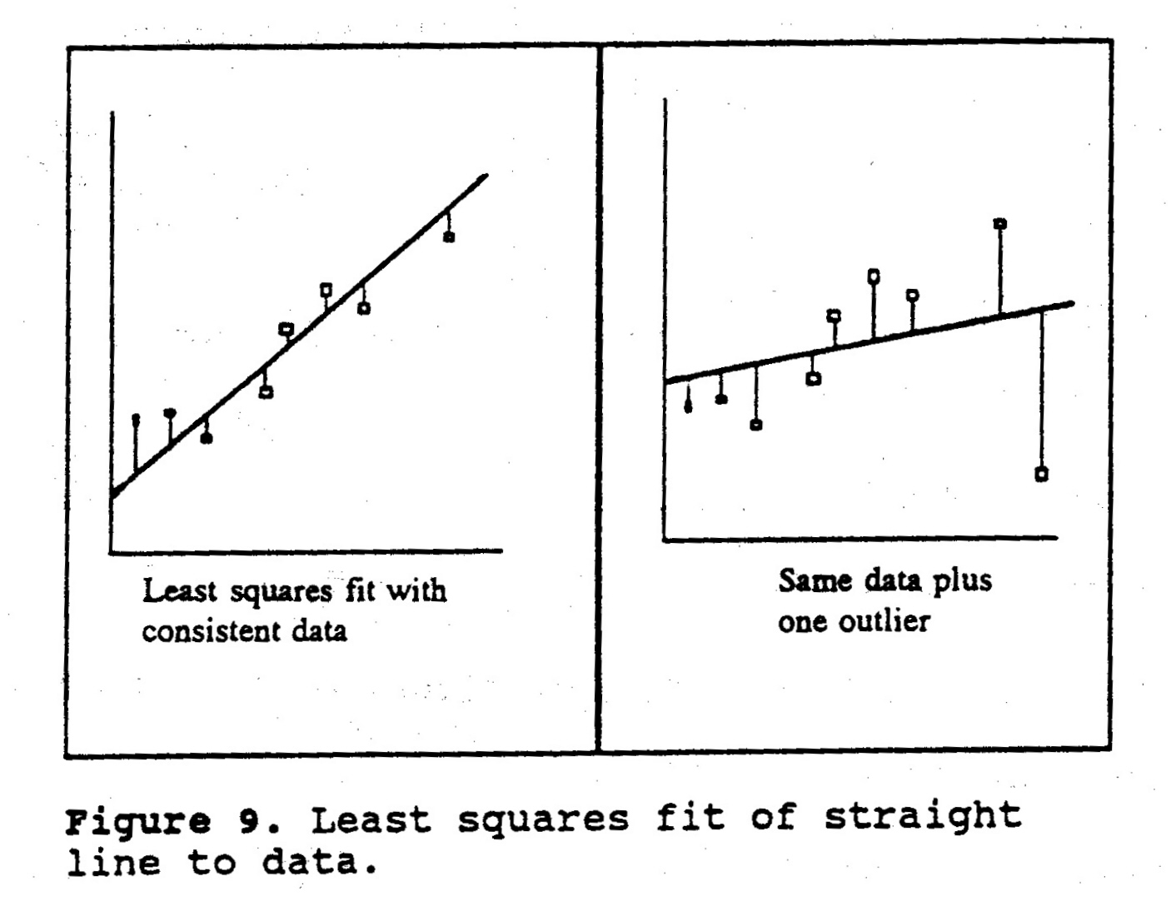

Slide 11
Homework 7-1
To write a half-space earthquake location program to locate the earthquake of the file 21032239.P01
Nsta.dat for the station coordinates
Cdis.for for converting long. & lat. To km

Slide 12
Cdis.f90
subroutine delaz(elat,elon,slat,slon,dx,dy,delta)
avlat=0.5*(elat+slat)
a=1.840708+avlat*(.0015269+avlat*(-.00034+avlat*(1.02337e-6)))
b=1.843404+avlat*(-6.93799e-5+avlat*(8.79993e-6+avlat*(-6.47527e-8)))
dlat=slat-elat
dlon=slon-elon
dx=a*dlon*60.
dy=b*dlat*60.
delta=sqrt(dx*dx+dy*dy)
End subroutine delaz

Slide 13
Nsta.dat
TAP 2502.35N12131.35E 5.5 001057030.013 0622 0597 0000 -1-1-1 000000 032028
TAP 2502.35N12131.35E 5.5 001057030.026 0622 0597 0000 -1-1-1 032029 041816
TAP 2502.35N12131.35E 5.5 001057030.006 0622 0597 0000 -1-1-1 041817 992431
HSN 2448.13N12058.17E 002095030.013 3443 0828 0000 -1-1-1 000000 910831
HSN 2449.79N12100.36E 34.0 002095030.013 3443 0828 0000 -1-1-1 910901 022231
HSN 2449.79N12100.36E 34.0 002095A30.013 3443 0828 0000 -1-1-1 022301 992431
TCU 2408.85N12040.56E 84.0 003061030.013 0622 0475 0000 -1-1-1 000000 910528
TCU 2408.85N12040.56E 003061030.044 0622 0475 0000 -1-1-1 910529 930630
TCU 2408.85N12040.56E -66.0 003061040.044 0622 0475 0000 -1-1-1 930701 992431
CHY 2329.86N12025.47E 26.9 004066030.013 3805 3598 0000 -1-1-1 000000 910528

Slide 14
File I/O Open Close ASCII, Binary File

Slide 15
File I/O
Open and Close
Read and Write
Inquire

Slide 16
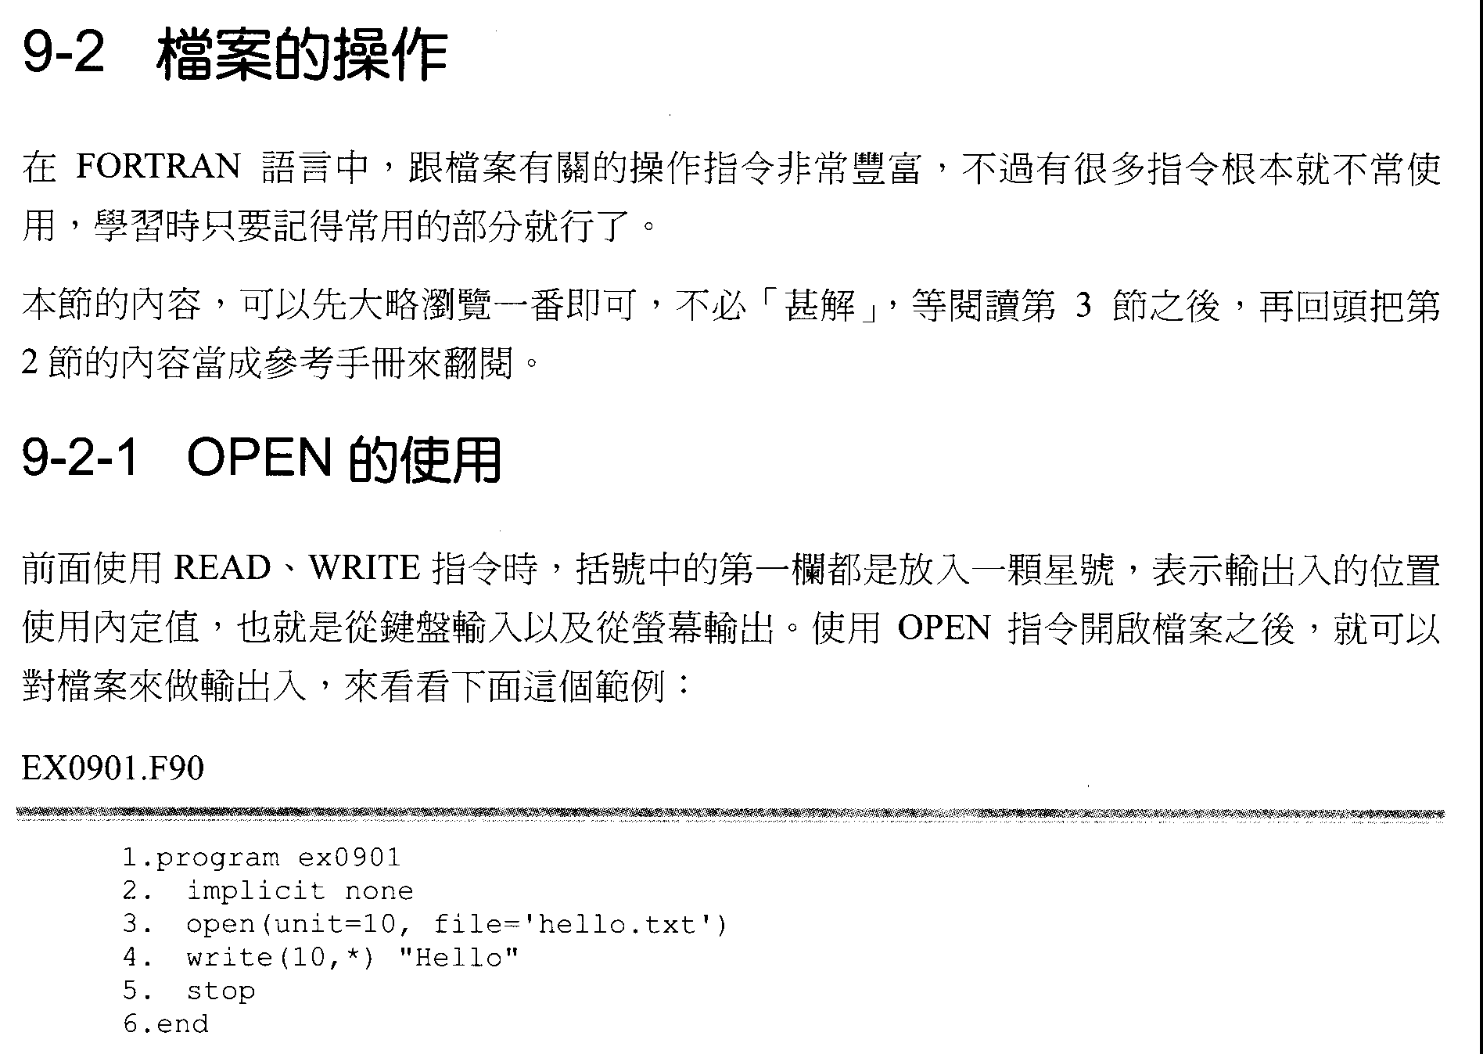
Files Operation
In FORTRAN, plenty commands are about files operation, but many of them are seldom to be used. Remember the common used commands is good enough.
The content in this section can be briefly scaned without totally understanding. After reading section 9-3, section 9-2 can be used as reference.
The way to use OPEN
When using READ and WRITE, an asterisk is put in the first column in the parenthesis to indicate that the position used for input and output is a default value (which means input from the keyboard and output on the screen). If a file is opened with OPEN, the file can be used as input and output. Let’s see an example:

Slide 18
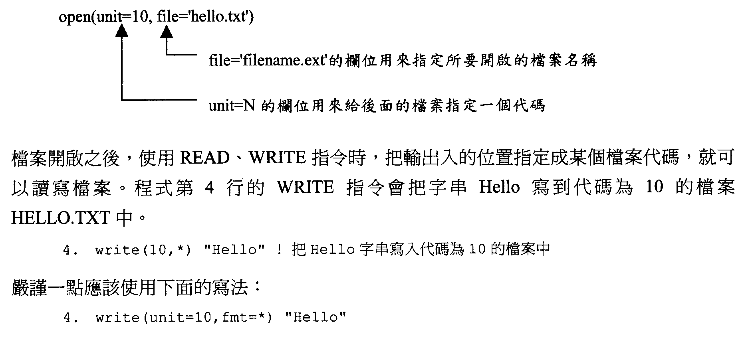
indicates the filename to be opened
is assigning a label to the opened file
After opening a file, assign the label of the file in READ and WRITE to read and write the file. The 4th line in the code below will write the string “Hello” in the file “TELLO.TXT” (labeled as 10) with the command WRITE.
A rigorous way to write the command:

Slide 20
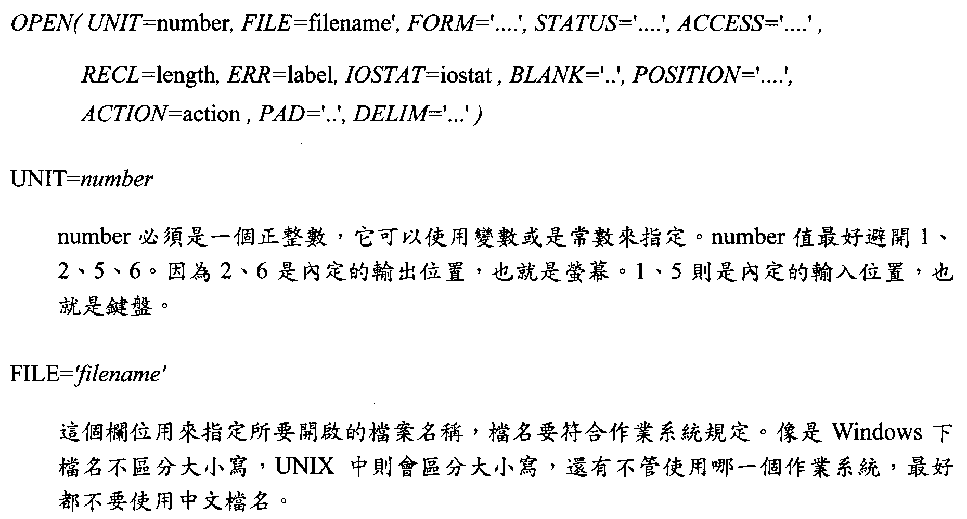
number must be an integer. It can be assigned by a variable or a constant. 1, 2, 5, and 6 are are better not to be assigned in number. 2 and 6 is the default output, which is screen. 1 and 5 is the default input, which is keyboard.
Assign the opened filename here. Filenames should follow the rule in OS. Windows doesn’t differentiate uppercase and lowercase, but UNIX does. No matter which OS is used, it’s better not to use Chinese in a filename.

Slide 22
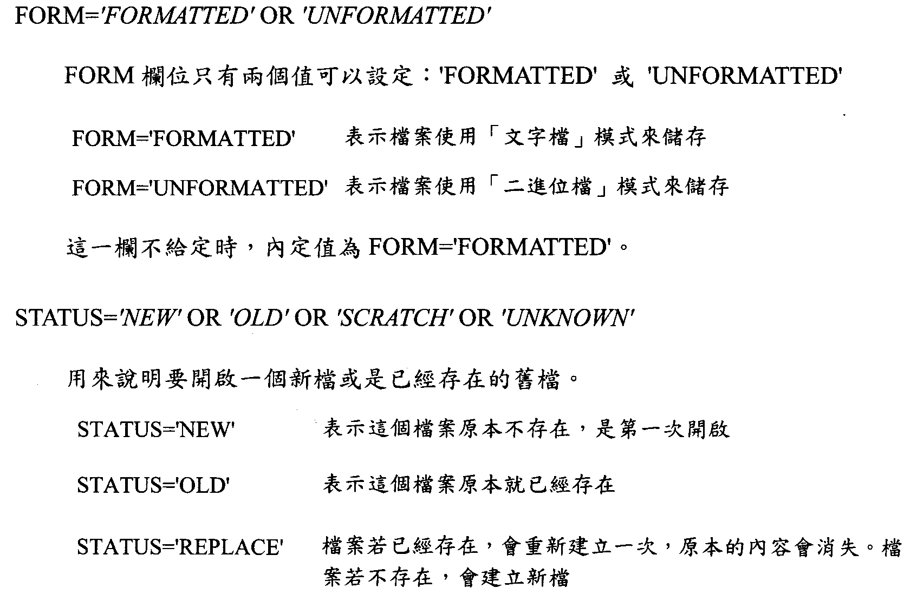
Text file format is used for saving
Bineary format is used for saving
Without assigning value, defalut is
Illustration of opening a new file or an existing old file
The file doesn’t exist. It’s the first time to open it
The file exist
If the file exist, replace the original one. If the file doesn’t exist, create a new one

Slide 24
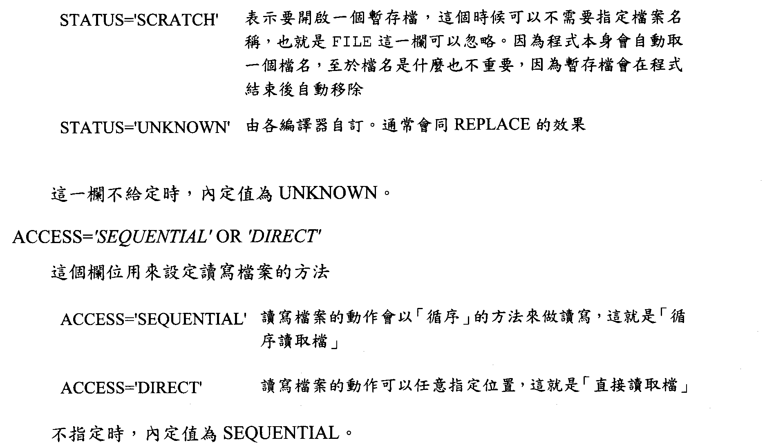
Open a temperary file. Filename is not required and FILE can be omitted. A temperary name will be assigned automatically. It’s not important to know the temperary filename, because the temperary file will be removed when the program is finished.
Depend’s on compiler. Usually, it is the same as REPLACE
Without assigning value, defalut is UNKNOWN.
Setting the way of reading files
Reading file in a ‘SEQUENTIAL’ way. This is ’sequential access’
Reading file with freely assigning location. This is direct access’
Without assigning value, defalut is SEQUENTIAL.

Slide 26
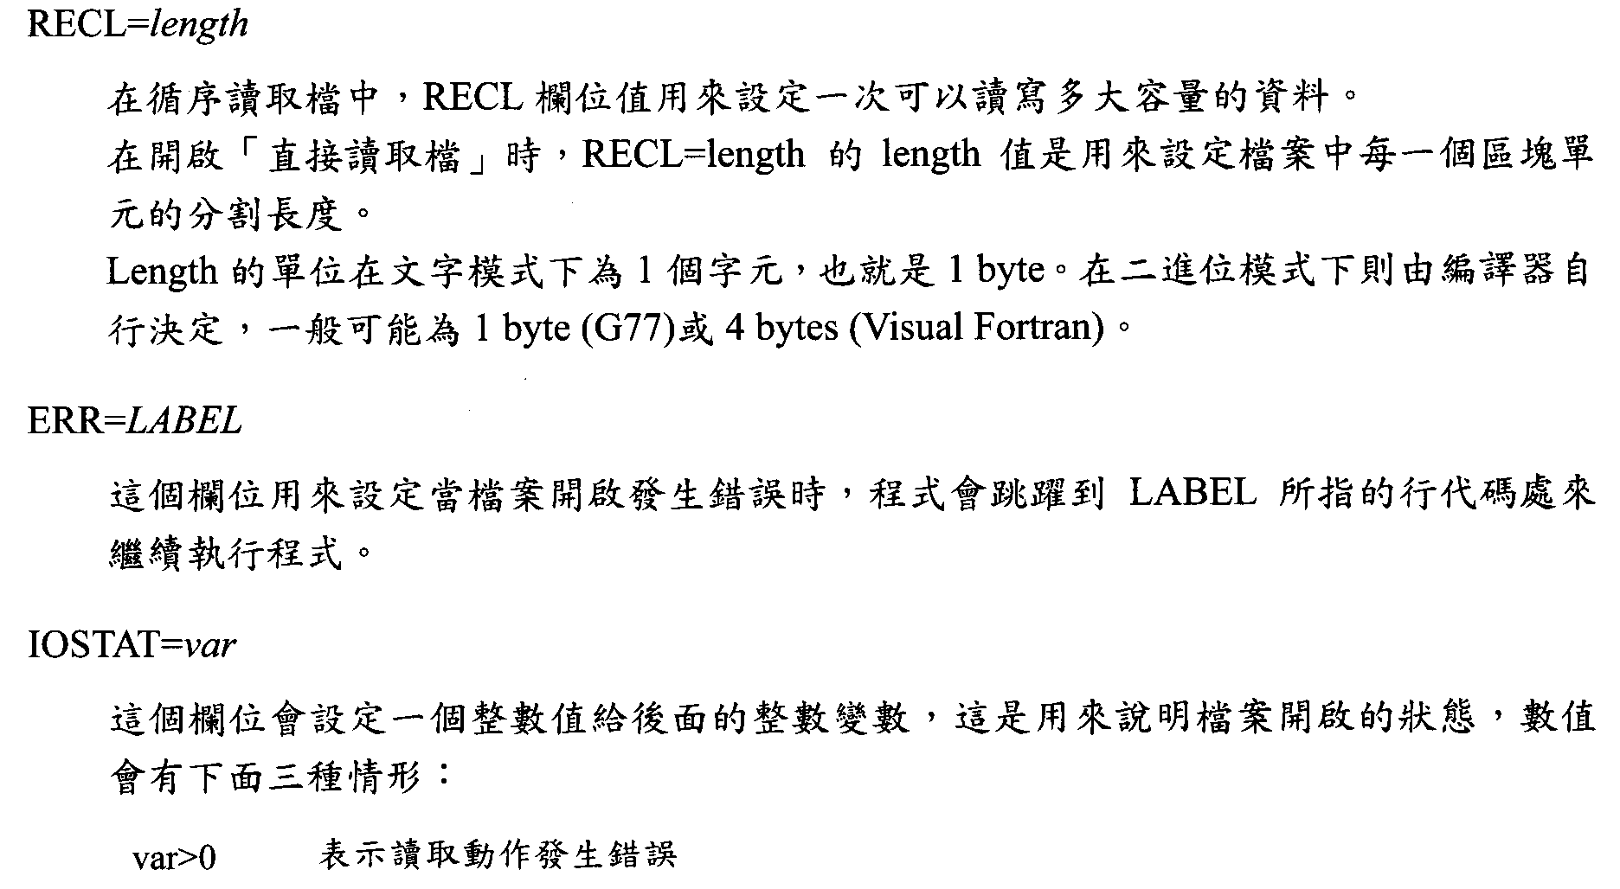
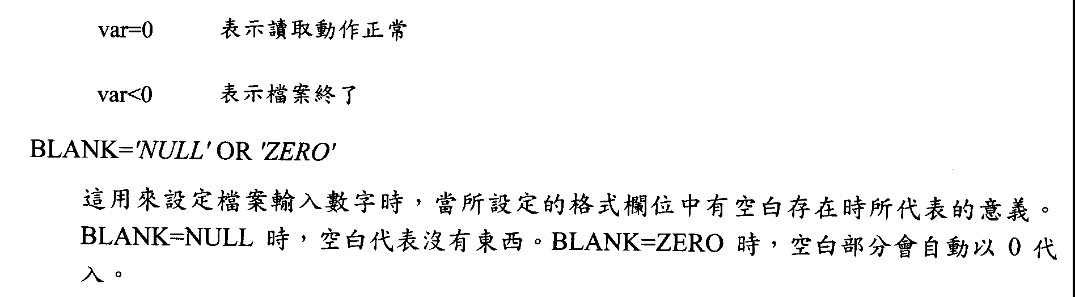
In sequential access, RECL is used to set the length of the data for reading in one time. In direct access, RECL=length can be used to assign a value about unit length in a file.
Length in text file format is 1 byte. In boneary format, it will be decided by compiler. It could be 1 byte (G77) or 4 bytes (Visual Fortran).
When error happens with opening a file, the program will goto the line labeled with the same assigned number here to continue its running.
Assign an integer value to the integer variable at right hand side, to indicate the open state of a file. The value has three possible cases:
Reading Error
Reading Normal
Finish Reading
When numbers are input, this setting indicates the meaning of blanks.
When BLANK=NULL, blanks mean null. When BLANK=ZERO, blanks will be replaced by 0.

Slide 28
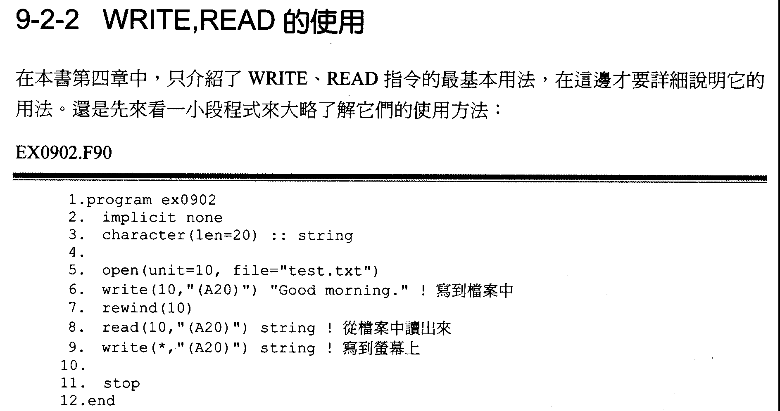
In Chapter 4, the basic way to use WRITE and READ is introduced. Here will show the way to use them in detail. An example to show a simple way to use them:

Slide 30
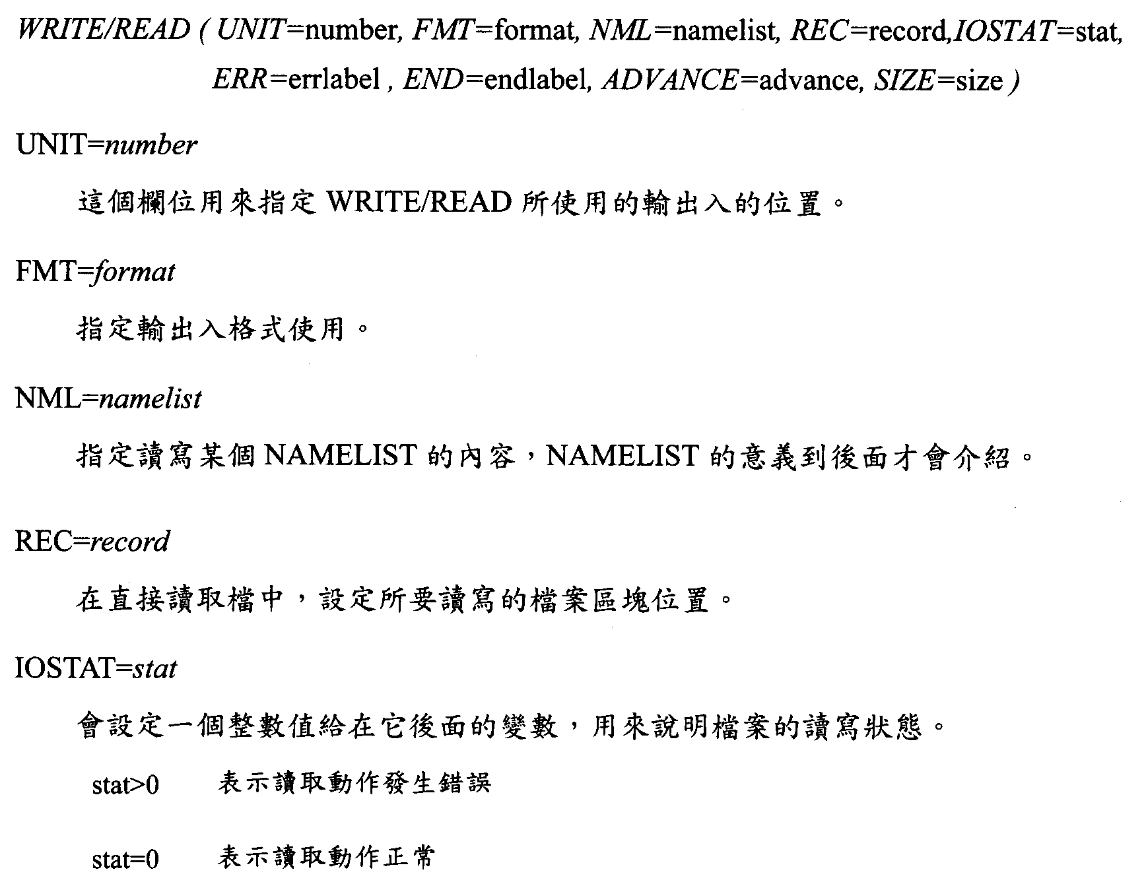
To assign the input and output position for using WRITE/READ.
To assign input and output format.
To assign to read a NAMELIST. The meaning of NAMELIST will be introduced later.
To assign the position for read and write with direct access.
Assign an integer value to the integer variable at right hand side, to indicate the reading state of a file.
Reading Error
Reading Normal

Slide 32
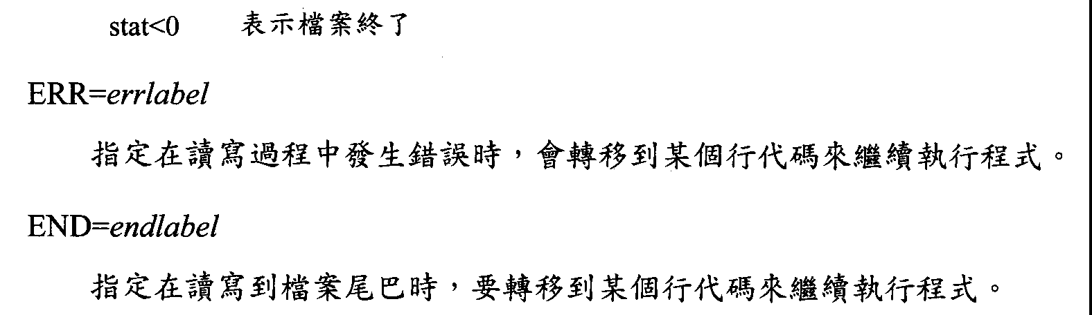
Finish Reading
If error happens in reading or writing, it will goto the assigned label and continue to run the program.
When read or write to the end of the file, it will goto the assigned label and continue to run the program.

Slide 34
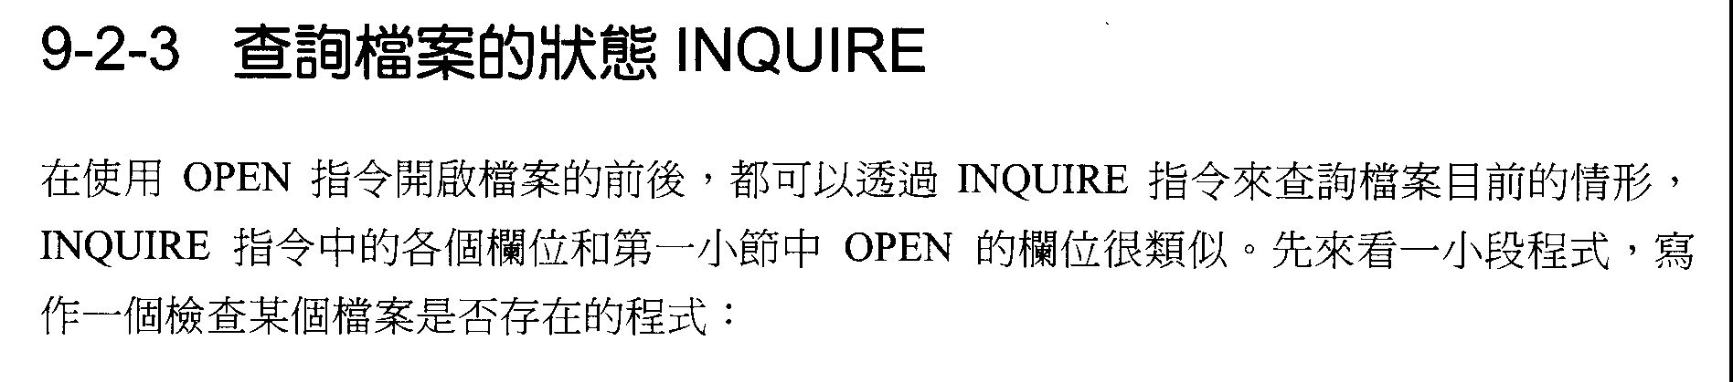
After a file is OPEN, the status of the file can be checked by INQUIRE. The format of INQUIRE is similar to OPEN. The following example is to check whether a file exist or not:

Slide 36
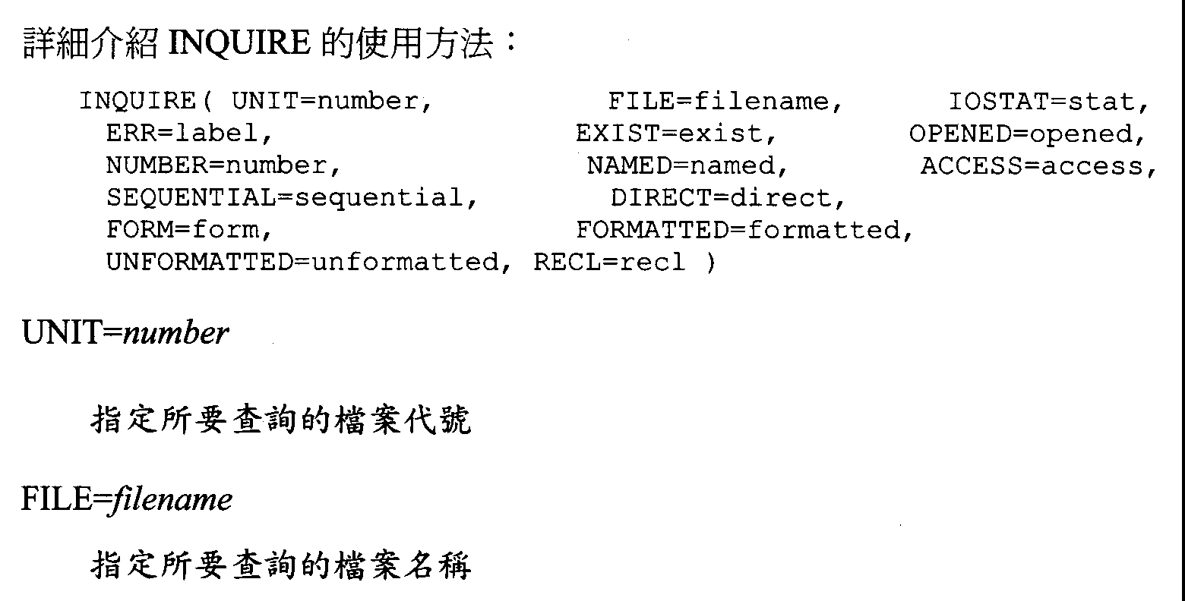
The label of the file to inquire
The filename of the file to inquire

Slide 38
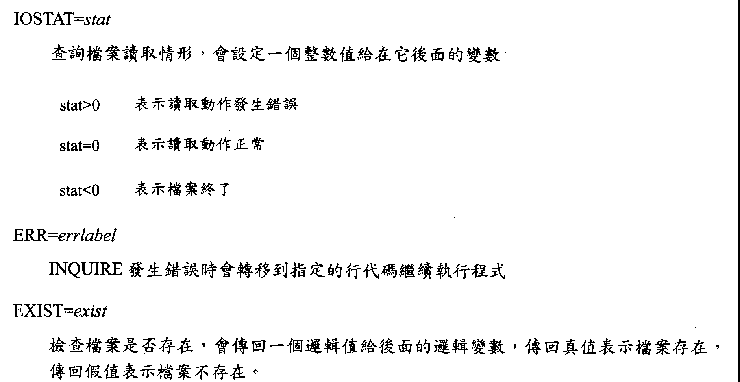
Assign an integer value to the integer variable at right hand side, to indicate the reading state of a file.
Reading Error
Reading Normal
Finish Reading
If error happens in INQUIRE, it will goto the assigned label and continue to run the program.
Inquire the existence of the file. A LOGIC will be returned to the logic variable at right hand side. If the return value is true, the file exist. If the return value is false, the file doesn’t exist.

Slide 40
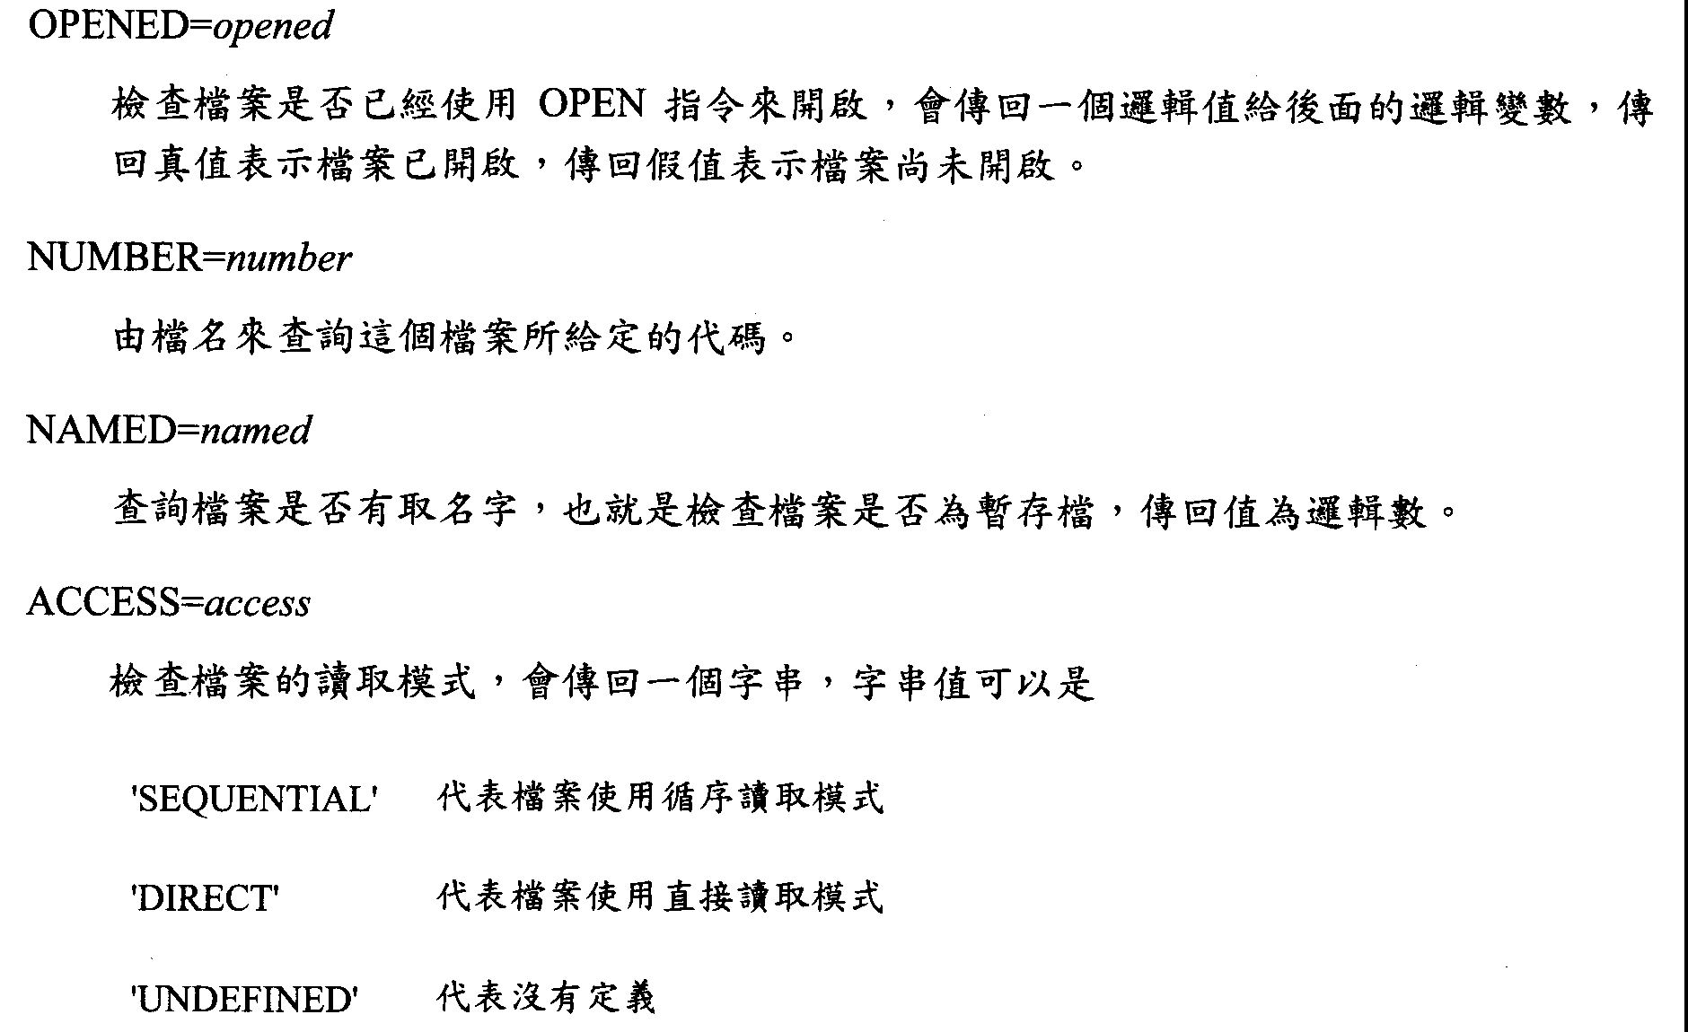
Inquire whether the file has been opened with command OPEN. A LOGIC will be returned to the logic variable at right hand side. If the return value is true, the file has been opened. If the return value is false, the file has not been opened yet.
Use filename to inquire the label assigned to the file.
Inquire whether the file has a name, which means to inquire the file is a temporary file or not. Return value is a LOGIC.
Inquire the reading mode of the file. A string will be returned. The string can be
The file is sequential access
The file is direct access
The access way is undefined

Slide 42
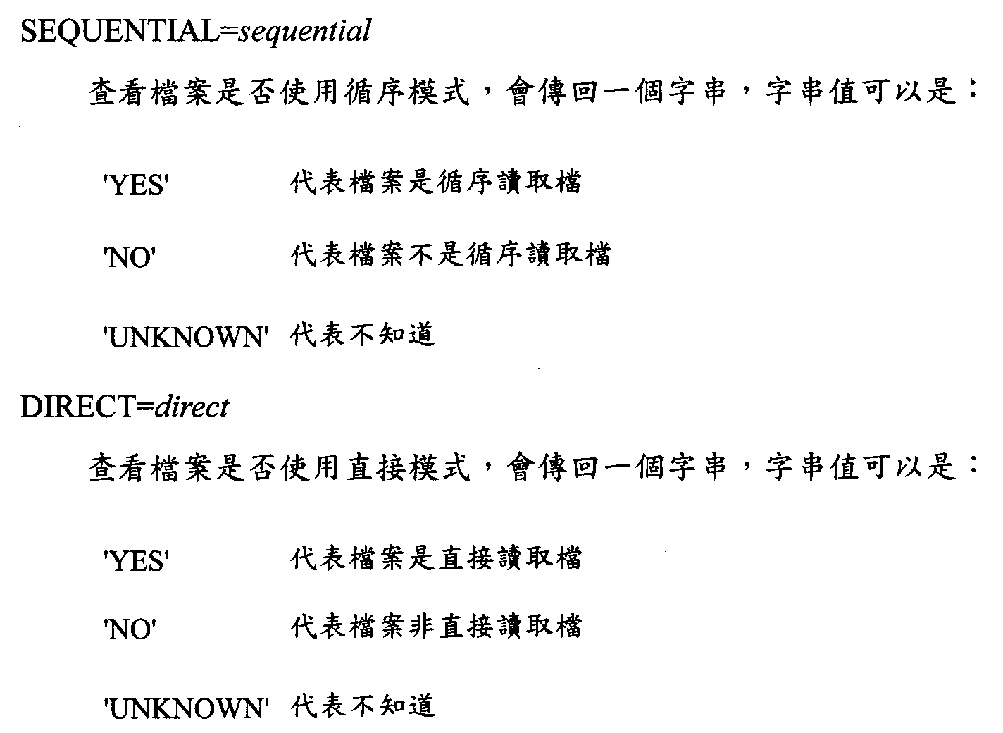
Inquire whether the file is with sequential access. A string will be returned. The string can be:
Inquire whether the file is with direct access. A string will be returned. The string can be:

Slide 44
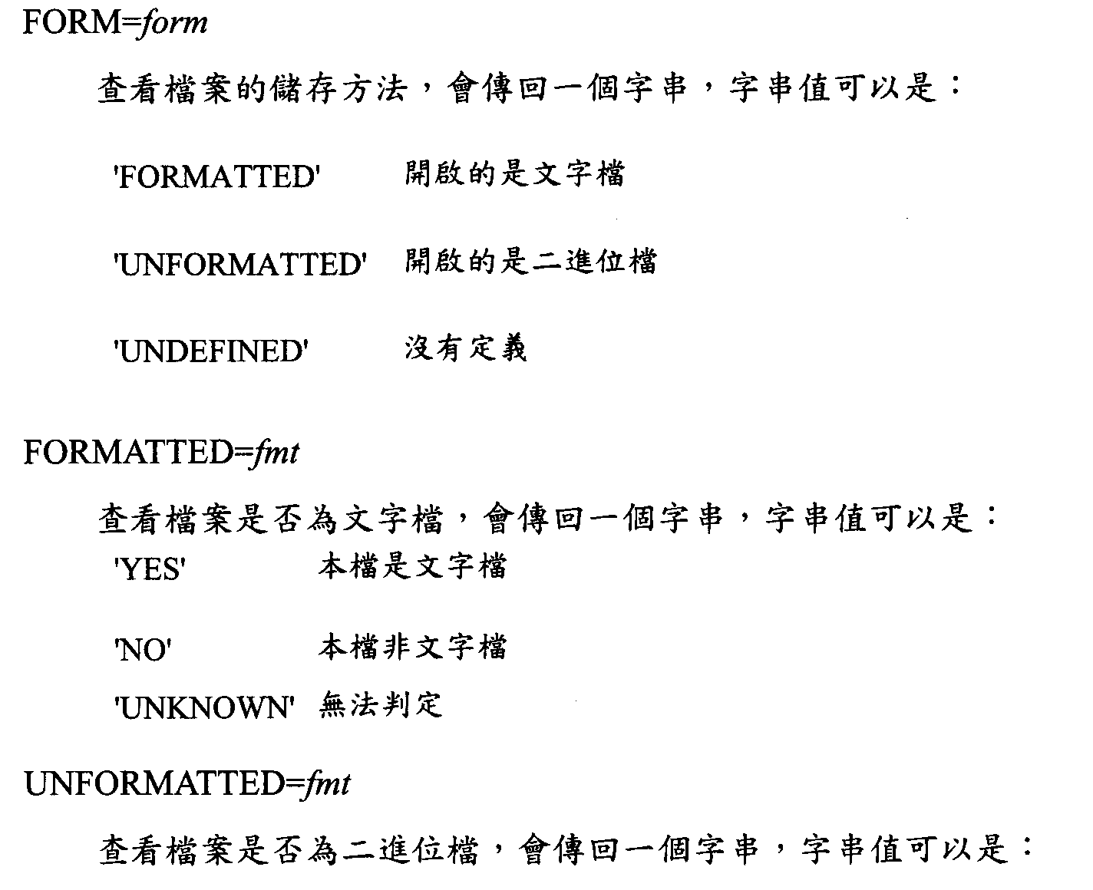
Inquire the saving form of the file. A string will be returned. The string can be:
Inquire whether the file is text format. A string will be returned. The string can be:
Inquire whether the file is binary format. A string will be returned.
The string can be:

Slide 46
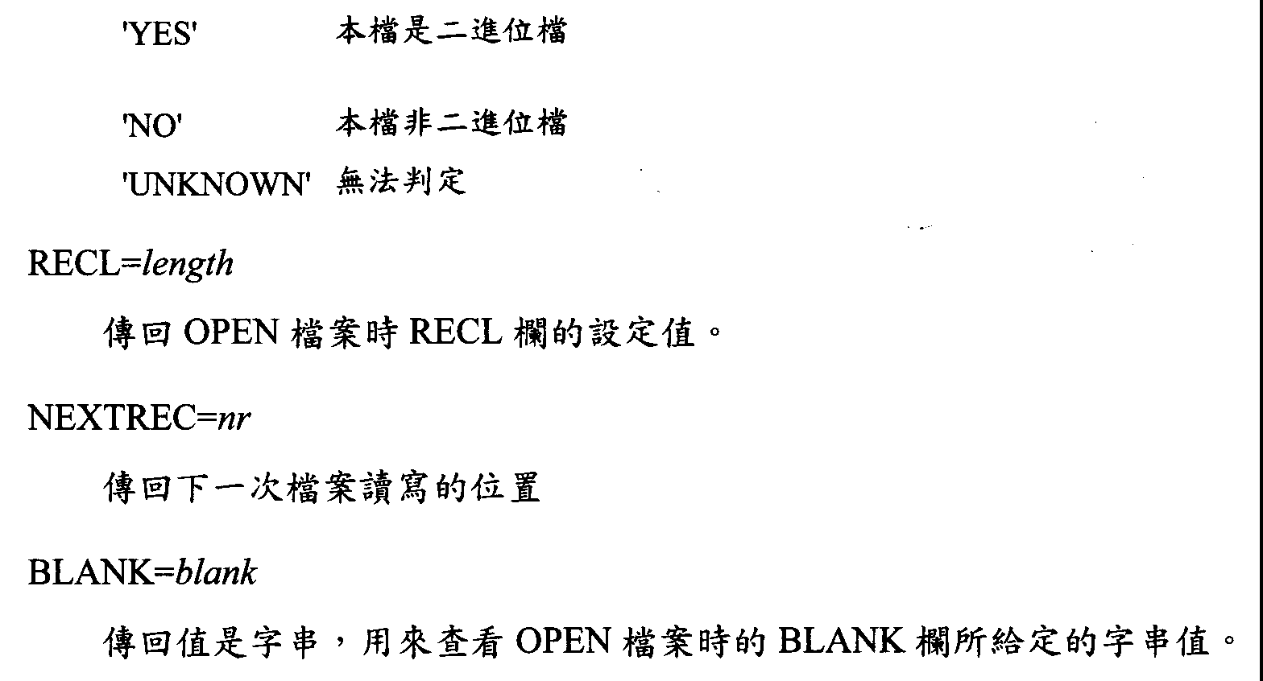
Inquire the setting value of RECL when OPEN a file.
Inquire the next reading/writing position of the file.
Return a string. Inquire the assigned string to the blanks when OPEN a file.

Slide 48
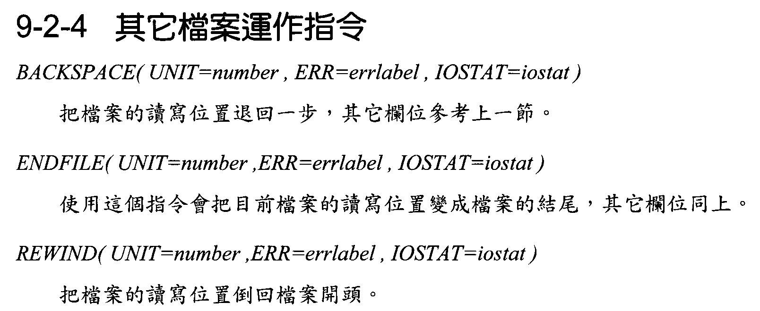
Other commands of file operation
Go back an unit of the reading/writing position of the file. Its arguments can refer to previous section.
Move the reading/writing position to the end of the file. Its arguments are as above.
Rewind the reading/writing position to the start of the file.

Slide 50
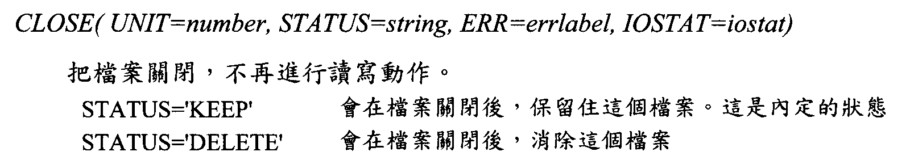
Close the file. Stop doing any reading or writing.
Keep the file after it is closed. It is the default setting.
Delete the file after it is closed.

Slide 52
Homework 8
Please read waveform from seismicdata.bin (binary file) and plots seismogram.
Limited only two times reading
Hint using type and dynamic array
Gfortran open(8,file=' seismicdata.bin', status='old', form='unformatted', access='stream')

Slide 53
Type
Type :: Header
character*4 Code
real*8 orgintime
integer*2 ncom
integer*4 ndata
real dt
character*4 blk
End type Header
Type (header) :: wh
Read(8)wh

Slide 54
Type
Wh%ndata → number of data point
Wh%dt → sampling interval (s)
Data type ncom*ndata in real (cm/s/s)
real, allocatable :: wd(:,:)
Allocate (wd(wh%ncom,wh%ndata))
Read(8)wd

